Slide 1




Implement Immutable AKS Infrastructure with Bicep
Infrastructure as Code User Group Oslo
25.05.2021
with Evgeny Borzenin

Slide 2





Learn more about AKS https://aka.ms/azure-aks
Get your next Learner digital badge of Azure Heroes program https://aka.ms/digital-badge
Win a cool Microsoft backpack!
Don’t forget to add Microsoft Azure skill to your LinkedIn account to stay connected with a developer community
+ Microsoft Azure
We post the latest announces about free events for the developers in Norway on our official Twitter account
@MSDevNo

Slide 3
Infrastructure as Code User Group 2021 roadmap
AKS workshops roadmap:
[x] AKS and Kubernetes 101
[x] Advanced AKS configuration
[ ] Implement Immutable AKS Infrastructure on Azure with Bicep
[ ] Monitoring in AKS
[ ] Service mesh with linkerd
[ ] AKS application deployment strategy
[ ] AKS security
+ “regular” events (work in progress)
If you have any good AKS / Kubernetes / IaC story – welcome to share!

Slide 4
Practical information
Mix of slides and labs with focus on labs
I don’t have moderator
Let’s help each other, the one who finished earlier can help others
Keep the same names as in labs -> easier to troubleshot
Share your screen if you stack with some issues
Labs are available after the event

Slide 5
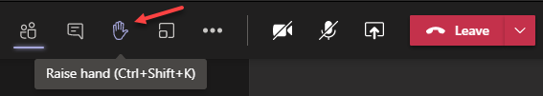
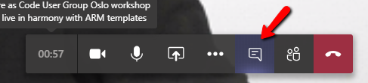

Microsoft Teams 101
Mute your mic (but don’t forget to unmute when you speak)
Feel free to use video
«Rise your hand» if you need some attention
Conversation/chat
Share screen

Slide 6
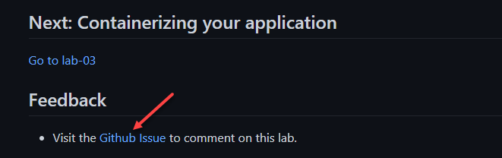
Practical information
Each lab is time-boxed (ish…)
When you completed a lab, please post to the Conversation channel
lab-01 (lab-02, lab-03 etc…)
Feel free to contribute to the labs content by fixing gramma, typos, wrong commands etc..
Feel free to comment on each lab

Slide 7
Bicep intro

Slide 8
Azure Terminology
resource
resource group
resource provider
Resource Manager template (aka ARM template)
declarative syntax
Notes:
resource - A manageable item that is available through Azure. Virtual machines, storage accounts, web apps, databases, and virtual networks are examples of resources.
resource group - A container that holds related resources for an Azure solution.
resource provider - A service that supplies Azure resources. For example, a common resource provider is Microsoft.Compute, which supplies the virtual machine resource. Microsoft.Storage is another common resource provider.
Resource Manager template - A JSON file that defines one or more resources to deploy to a resource group or subscription. The template can be used to deploy the resources consistently and repeatedly.
declarative syntax - Syntax that lets you state "Here is what I intend to create" without having to write the sequence of programming commands to create it. The Resource Manager template is an example of declarative syntax. In the file, you define the properties for the infrastructure to deploy to Azure.

Slide 9
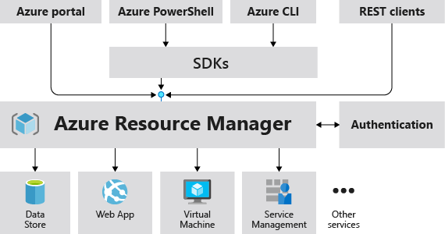
What is Azure Resource Manager?
Azure Resource Manager is the deployment and management service for Azure
Provides a management layer to create, update, and delete resource
Notes:
Azure Resource Manager is the deployment and management service for Azure
It provides a management layer that enables you to create, update, and delete resources in your Azure subscription.
When a user sends a request from any of the Azure tools, APIs, or SDKs, Resource Manager receives the request.
It authenticates and authorizes the request. Resource Manager sends the request to the Azure service, which takes the requested action.
Because all requests are handled through the same API, you see consistent results and capabilities in all the different tools.
All capabilities that are available in the portal are also available through PowerShell, Azure CLI, REST APIs, and client SDKs.
Functionality initially released through APIs will be represented in the portal within 180 days of initial release.

Slide 10
Resource groups
All the resources in your group should share the same lifecycle.
Each resource can only exist in one resource group.
You can move a resource from one resource group to another group.
A resource group can contain resources that are located in different regions.
The resource group stores metadata about the resources.
A resource can interact with resources in other resource groups.
Notes:
The resource group stores metadata about the resources. When you specify a location for the resource group, you're specifying where that metadata is stored.
If the resource group's region is temporarily unavailable, you can't update resources in the resource group because the metadata is unavailable. The resources in other regions will still function as expected, but you can't update them.

Slide 11
What is ARM template?
JSON file that defines the infrastructure and configuration
Uses declarative syntax
Contains resources to deploy and the properties for those resources
Notes:
The template is a JavaScript Object Notation (JSON) file that defines the infrastructure and configuration for your project.
The template uses declarative syntax, which lets you state what you intend to deploy without having to write the sequence of programming commands to create it.
In the template, you specify the resources to deploy and the properties for those resources.

Slide 12
Why choose ARM templates?
Declarative syntax
Idempotentcy
Create any Azure resource
Tracked deployments
Exportable code
Orchestration
Notes:
Declarative syntax: ARM templates allow you to create and deploy an entire Azure infrastructure declaratively. For example, you can deploy not only virtual machines, but also the network infrastructure, storage systems and any other resources you may need.
Idempotentcy: Repeatedly deploy your infrastructure throughout the development lifecycle and have confidence your resources are deployed in a consistent manner. Templates are idempotent, which means you can deploy the same template many times and get the same resource types in the same state.
Create any Azure resource: You can immediately use new Azure services and features in templates. As soon as a resource provider introduces new resources, you can deploy those resources through templates. You don't have to wait for tools or modules to be updated before using the new services.
Tracked deployments: In the Azure portal, you can review the deployment history and get information about the template deployment. You can see the template that was deployed, the parameter values passed in, and any output values. Other infrastructure as code services aren't tracked through the portal.
Exportable code: You can get a template for an existing resource group by either exporting the current state of the resource group, or viewing the template used for a particular deployment. Viewing the exported template is a helpful way to learn about the template syntax.

Slide 13
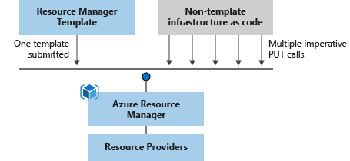
Why choose ARM templates?
Notes:
Orchestration: You don't have to worry about the complexities of ordering operations. Resource Manager orchestrates the deployment of interdependent resources so they're created in the correct order. When possible, Resource Manager deploys resources in parallel so your deployments finish faster than serial deployments. You deploy the template through one command, rather than through multiple imperative commands.

Slide 14





What’s wrong with ARM templates?

Slide 15

IaC story at Vipps
ARM
az cli,
bash
ARM rest API with python
ARM
az cli, bash
Generate ARM with F#, C#, Python
ARM
az cli, bash
Terraform
Pulumi

Slide 16
What’s the problem with ARM?
Authoring
Tooling
Review changes/Deployment Plan/what-if

Slide 17
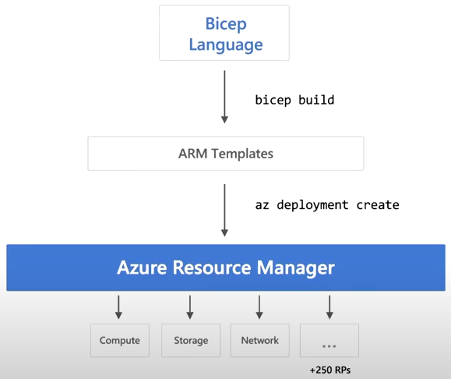
What is Bicep?
Notes:
Azure Bicep is a new declarative Domain Specific Language (DSL) for deploying Azure resources. The goal of this new language is to make it easier to write Infrastructure as Code (IaC) targeting Azure Resource Manager (ARM) using a syntax that’s more friendly than the JSON syntax of Azure ARM Templates.
Azure Bicep works as an abstraction layer built on top of ARM Templates. Anything that can be done with Azure ARM Templates can be done with Azure
Bicep as it provides a “transparent abstraction” over ARM (Azure Resource Manager). With this abstraction, all the types, apiVersions, and properties valid within ARM Templates are also valid with Azure Bicep.
Azure Bicep is a compiled / transpiled language. This means that the Azure Bicep code converted into ARM Template code. Then, the resulting ARM
Template code is used to deploy the Azure resources. This transpiling enables Azure Bicep to use it’s own syntax and compiler for authoring Azure Bicep files that compile down to Azure Resource Manager (ARM) JSON as a sort of intermediate language (IL).

Slide 18
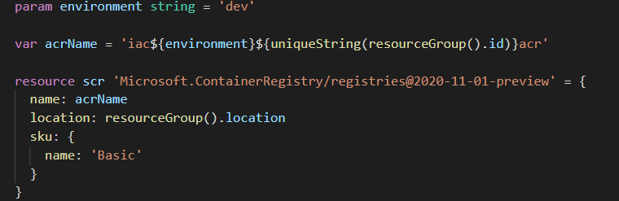
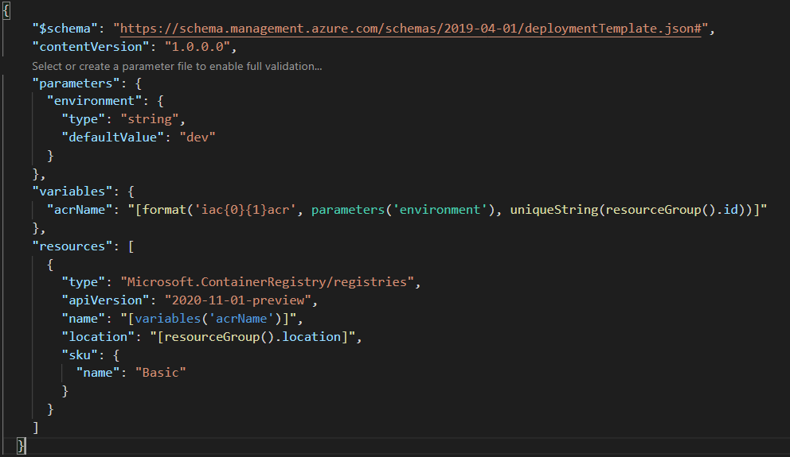
What is Bicep?

Slide 19
What is Bicep?
Generate ARM templates first az bicep build -f ./infra.bicep az deployment group what-if -f ./infra.json -g iac-dev-rg az deployment group what-if -f ./infra.json -g iac-dev-rg
Use az-cli az deployment group what-if -f ./infra.bicep -g iac-dev-rg az deployment group create -f ./infra.bicep -g iac-dev-rg

Slide 20
Why use Azure Bicep?
Declarative syntax
Idempotentcy
Create any Azure resource
Tracked deployments
Exportable code
Orchestration
Improved authoring experience
Modularization
Tooling
+
Notes:
Azure Resource Manager and ARM Templates are written in a JSON syntax that can be cumbersome to work with. Azure Bicep is a Domain Specific Language (DSL) that offers a transparent abstraction over Azure Resource Manager and ARM Templates that offers support for a cleaner code syntax with better support for modularity and code re-use. Azure Bicep offers a few improvements for authoring Azure IaC over the use of ARM Template JSON.
Azure Bicep tooling offers a high level of discoverability and validation

Slide 21
Lab 01 – 15 min

Slide 22
Variables, Parameters, Outputs, Modules, Scopes

Slide 23
Variables, Parameters, Outputs, Modules, Scopes

Slide 24

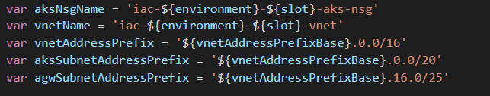
Parameters
Notes:
Parameters in an ARM Template are variables that are passed into the template at deployment time; generally via a file with the parameters.json extension; such as main.parameters.json.
In Azure Bicep, you can also declare parameters in your .bicep file. These parameters can be required to be passed in when the template is deployed, or the parameters can be given a default value if they aren’t passed in.

Slide 25

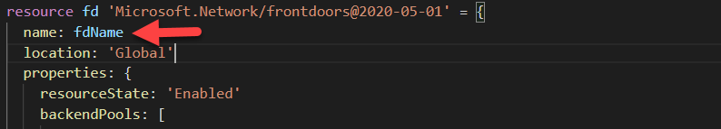
Variables
Notes:
Variables in an Azure Bicep are used to store values and declare complex expressions that can be used one or more times by referencing them throughout the template.
The declaration and use of variables in Azure Bicep is the same as how they are used in ARM Templates.
Azure Bicep variables are defined by using the var keyword followed by the variable name, then followed by the equal sign (=) and the value to assign to the variable. This is done using the following format:

Slide 26

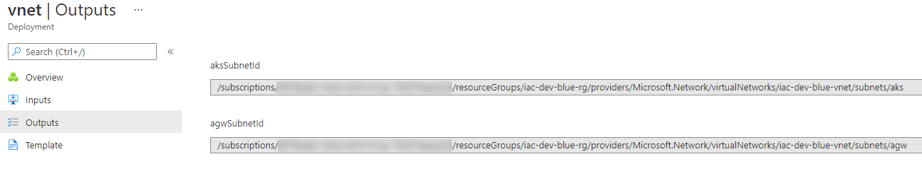
Outputs
Notes:
Output variables are used to output some values from the template after it is deployed into Microsoft Azure. In Azure Bicep, output variables are declared using a similar syntax to variables used within the template but using the output keyword for declaration.

Slide 27
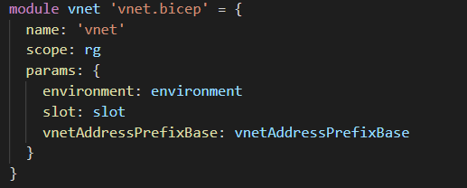
Modules
Bicep template
VNet module
AGW module
AKS module
Notes:
Bicep modules enable you to organize and reuse your Bicep code by creating smaller units that can be composed into a template. Any Bicep template can be used as a module by another template.
A module is set of one or more resources to be deployed together. It only exposes parameters and outputs as contract to other Bicep files, hiding details on how internal resources are defined. This allows you to abstract away complex details of the raw resource declaration from the end user who now only needs to be concerned about the module contract. Parameters and outputs are optional.

Slide 28
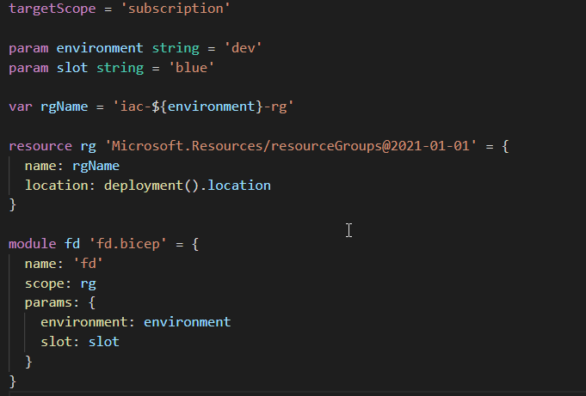
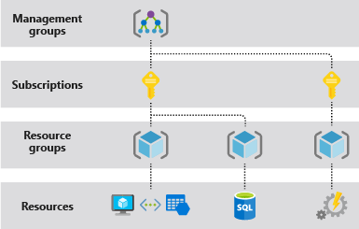
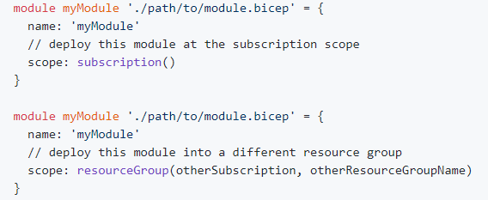
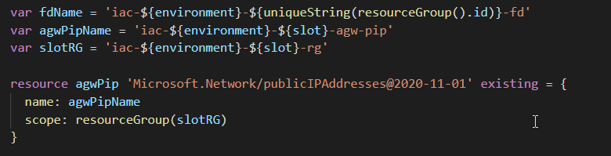
Scopes
Notes:
A deployment in ARM has an associated scope, which dictates the scope that resources within that deployment are created in. There are various ways to deploy resources across multiple scopes today in ARM templates; this spec describes how similar functionality can be achieved in Bicep.
Unless otherwise specified, Bicep will assume that a given .bicep file is to be deployed at a resource group scope, and will validate resources accordingly. If you wish to change this scope, or define a file that can be deployed at multiple scopes, you must use the targetScope keyword with either a string or array value as follows:

Slide 29
Lab 02 – Lab 05

Slide 30
Loops, Conditions, Referencing resource, and Converting existing ARM templates to Bicep

Slide 31
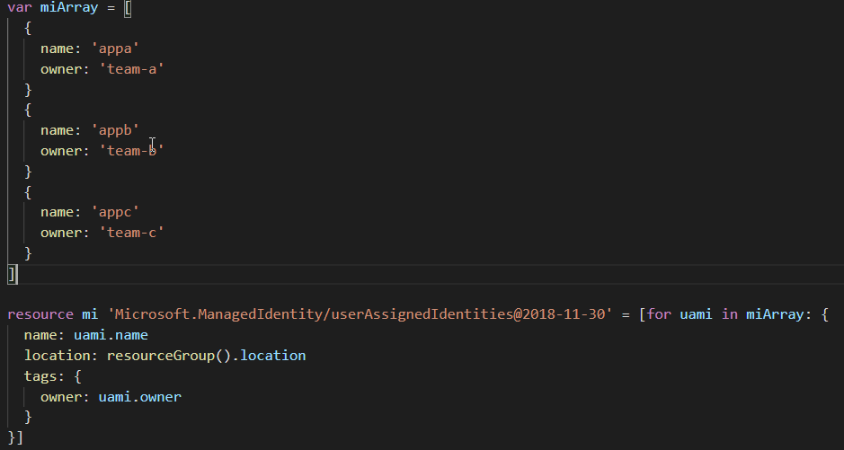
Loops
Resources
Variables
Modules
Etc…
Notes:
Loops may be used to iterate over an array to declare multiple resources/modules or to set an array property inside a resource/module declaration. Loops may also be used when defining variables.

Slide 32
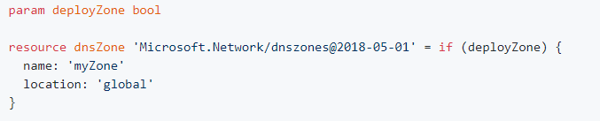
Conditions
Notes:
Resources may be deployed if and only if a specified condition evaluated to true. Otherwise, resource deployment will be skipped. This is accomplished by adding a if keyword and a boolean expression to the resource declaration. The template compiled from the below example will deploy the DNS zone if the deployZone parameter evaluates to true:

Slide 33
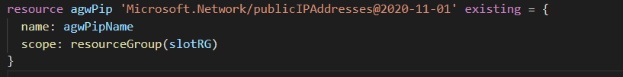
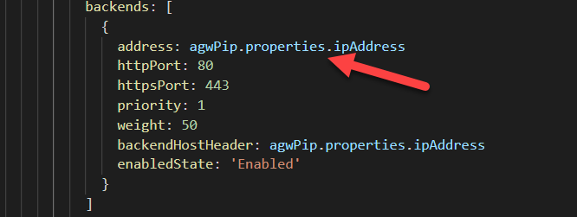
Referencing existing resources
Notes:
You may add references and access runtime properties from resources outside of the current file by using the existing keyword in a resource declaration. This is equivalent to using the ARM Template reference() function.
When using the existing keyword, you must provide the name of the resource, and may optionally also set the scope property to access a resource in a different scope. See Resource Scopes for more information on using the scope property.

Slide 34
Lab 06 – Lab 07

Slide 35
Implement immutable AKS infrastructure

Slide 36







Workshop use-case
iac-dev-rg
Front Door
Container Registry
iac-dev-blue-rg
iac-dev-green-rg
agw
agw
aks
aks
iac-dev-blue-vnet
iac-dev-green-vnet

Slide 37
Lab 08 – Lab 09

Slide 38
Deployment strategy
I don’t care about ARM template, just deploy!
I already have deployment strategy for ARM templates
CI/CD tools
Bicep Code
Build
CI
Azure
CI/CD tools
Bicep Code
Build
CI
Release
CD
Azure
ARM

